Slide 1


OSLO Air and Water:
Workshop 2
Welcome!
Thursday March 4th 2021
Virtual working group – Microsoft Teams

Slide 2

Purpose of today
Give a recap of TW1 and address the questions raised
Going over changes to Core, Water & Air models
Addressing questions and remarks from TW1
Detailing collaboration for definitions
Notes:
Kevin

Slide 3
Agenda
Topic | Time (mins) | Timestamps
Start TW2 | 5 mins | 13:05
Introduction & Who’s in the room | 10 mins | 13:15
Recap of Thematic Workshop 1 | 5 mins | 13:20
Changes since TW1 - Core model | 15 mins | 13:35
Changes since TW1 - Air & Water | 10 mins | 13:45
Break | 15 mins | 14:00
Breakout Session & Debrief | 30 mins | 14:30
Specific Models brought up in TW1 | 15 min | 14:45
Questions for changes to the model | 30 min | 15:15
Definitions & Next steps | 15 min | 15:30

Slide 4



Practicalities
Audience sound is muted by default
Use your hand if you want to say something. Interaction is encouraged!
Video camera encouraged
Questions, comments and suggestions can be communicated via the chat function. Interaction is encouraged!
yes/no questions can be answered via chat:
Agree = +1
Do not agree = - 1
Indifferent = 0
Notes:
Kevin

Slide 5
Welcome and introduction
Notes:
Kevin

Slide 6

Who’s in the room?
5’
https://app.klaxoon.com/participate/board/H5KQMV8
Notes:
Kevin
https://app.klaxoon.com/animate/board/T9ZKYVV
anthony.van.heymbeeck@pwc.com
pass: pwcKLAXOON2021

Slide 7
Recap previous workshop
Notes:
Kevin

Slide 8

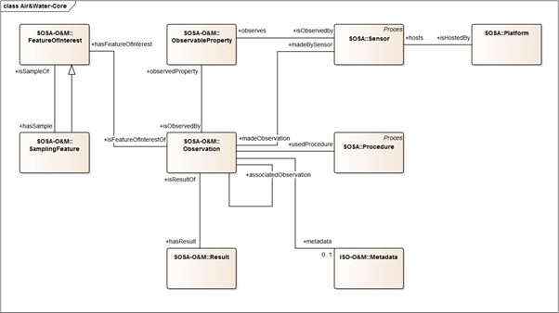
Recap TW1
Presented initial draft model for Air through simplified use case
Gathered input on
Similarity Air & Water model
Differences Air & Water model
Additional information that should be added to the model

Slide 9
Input received on the draft Air model

Slide 10
Agreement on Core elements of the model

Slide 11
Questions on specific use cases
What about:
Microorganisms as observable property
Sewer - Pollution
...

Slide 12
Quid general approach Observable Property?
… But also questions with regards to the range of observable properties that could be used & how we can tackle this. For example by looking into specific existing code lists such as QUDT...

Slide 13
But what about sampling methods?
Is there a way to document the sampling method?
Chromatograms?

Slide 14
Additional models to verify
Lastly, other models were also brought up to take into account:
W3 Cube
WISE (EU reporting on water pollutants)
WaterML

Slide 15
Models: ‘Core’, Air & Water
Changes since last thematic workshop
Notes:
Kevin

Slide 16
4 Principal Changes to the “Core” model

Slide 17
4 Principal Changes to the “Core” model
ISO O&M preferred over SOSA interpretation for the FeatureOfInterest, ObservableProperty, SamplingFeature, Observation & Results classes
1
ISO O&M definitions seem to be better aligned than SOSA
Modeling mismatch with SamplingFeature in SOSA

Slide 18
4 Principal Changes to the “Core” model
ISO O&M preferred over SOSA interpretation for the FeatureOfInterest, ObservableProperty, SamplingFeature, Observation & Results classes
1
O&M:Feature
O&M:Property
ISO O&M definitions seem to be better aligned than SOSA
Modeling mismatch with SamplingFeature in SOSA
O&M:SpatialSampling-Feature
O&M:Observation
O&M:Result

Slide 19
4 Principal Changes to the “Core” model
ISO O&M preferred over SOSA interpretation
1
First proposal of attributes based on O&M
2

Slide 20
4 Principal Changes to the “Core” model
SSN:System
ISO O&M preferred over SOSA interpretation
1
First proposal of attributes based on O&M
2
3
Addition of ‘System’ & ‘Devices’ to sensor & platform
FIWARE:Device
Alignment with SSN model
Sensor as a type of system with specific:
System capabilities
Operating Range
Survival range
Platform & System related to FIWARE:Devices

Slide 21
4 Principal Changes to the “Core” model
ISO O&M preferred over SOSA interpretation
1
First proposal of attributes based on O&M
2
3
Addition of ‘System’ & ‘Devices’ to sensor & platform
SOSA Extensions, the addition of Observation Collections
4
ObservationCollection
Aggregate observations taken by same sensor, at the same time, using same procedure, ...
SOSA-extension:ObservationCollection

Slide 22
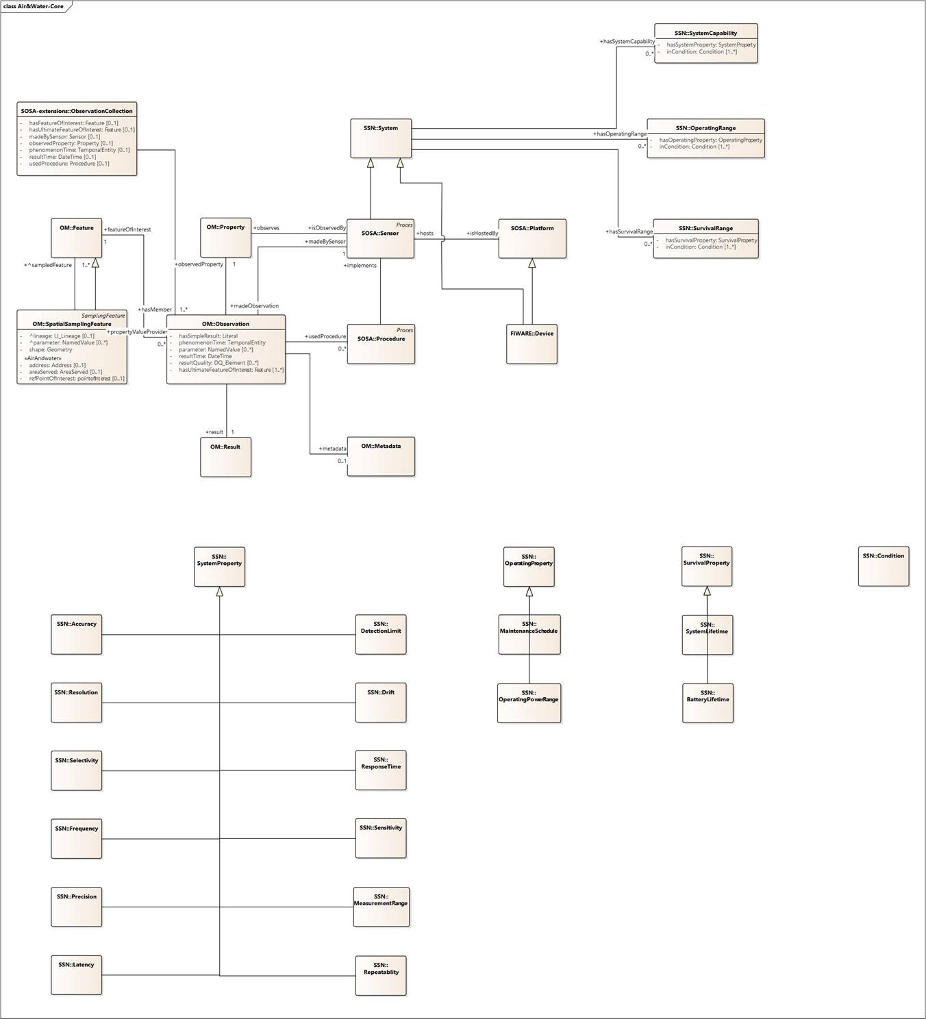
Revised Core Model
Accuracy
Resolution
Selectivity
Frequency
Precision
Latency
Detection Limit
Drift
Response time
Sensitivity
Measurement range
Repeatability
Maintenance Schedule
Operating Power range
System Lifetime
Battery Lifetime

Slide 23

Revised Core Model
ISO O&M preferred over SOSA interpretation
1
First proposal of attributes based on O&M
2
Do you agree (+1) or disagree (-1) with this change?

Slide 24
Revised Core Model
...with specific system capabilities, operating range & survival range...
Addition of ‘System’ & ‘Devices’ to sensor & platform
3
...which is a specific system...
...with a sensor...
...a specific property...
We observe...
...hosted on a specific platform.
Do you agree (+1) or disagree (-1) with this change?

Slide 25
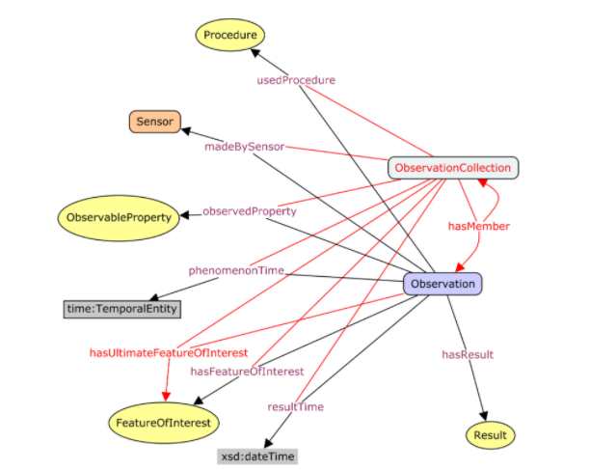
Revised Core Model
SOSA Extensions, the addition of Observation Collections
If present, any of these attributes apply to all member observations
4
Do you agree (+1) or disagree (-1) with this change?

Slide 26
Water model
Based on the core model
Notes:
Fre

Slide 27
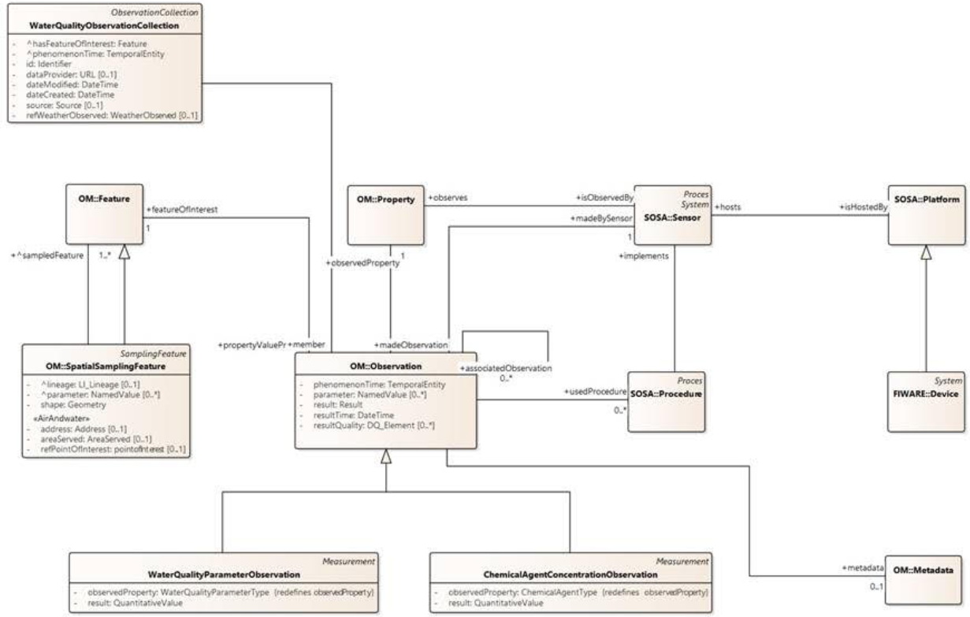
Water model based on FIWARE:WaterQuality

Slide 28
Water model Property, sensor and procedure
Sensor information
Property
What property is observed/measured by the sensor? (temperature, conductivity, pH, specific chemical agents)
Sensor
What sensor was used?
Platform
On what kind of platform was the sensor installed?
Device
Device information (dataProvider, ipAddress, hardwareVersion, …)
Procedure
What procedure was used?

Slide 29
Water model Metadata
Metadata information
Status of the observation: archived/cancelled/planned/acquired/…
Validity of your results
Archived status
...

Slide 30
Water model Observations
Feature of interest
What object do we observe?
Lake
Waterway
Sewer system
Spatial sampling feature
We cannot sample the entire lake, so we use specific sample points to represent the object
What proxy object do we observe?
Location
Sample

Slide 31
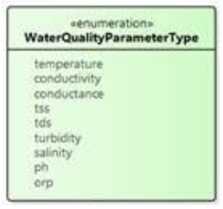
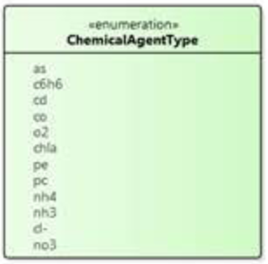
Water model Observations
Water Quality Parameter Observation
Chemical Agent Concentration Observation

Slide 32
Water model Observations
Observation information
The activity of observing
At what time?
Observation parameters?
Feature of interest
Date & time
Result
Observed property
...
Observation collection
A collection of one or more observations, whose members share a common value for one or more properties. (the next slide will put this in a more practical example)

Slide 33
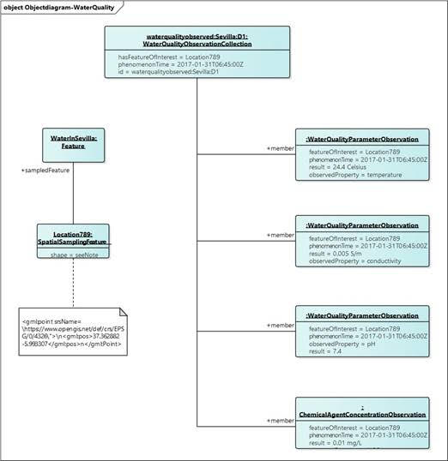
Water model Object diagram

Slide 34
Air model
Changes since the last thematic workshop
Notes:
Kevin

Slide 35
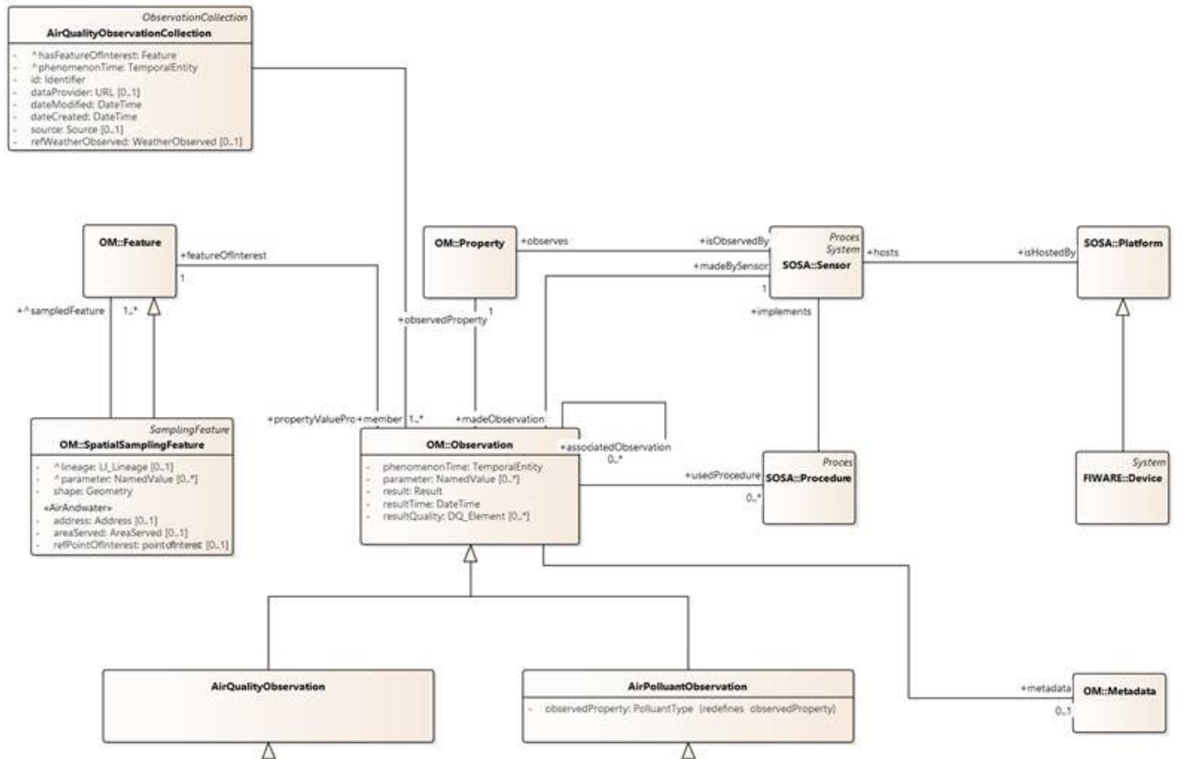
Air model based on the core model
Notes:
Talk about similarities with the other model going through it in detail (next slide)
Mention: Based on the FIWARE: Water Quality model

Slide 36
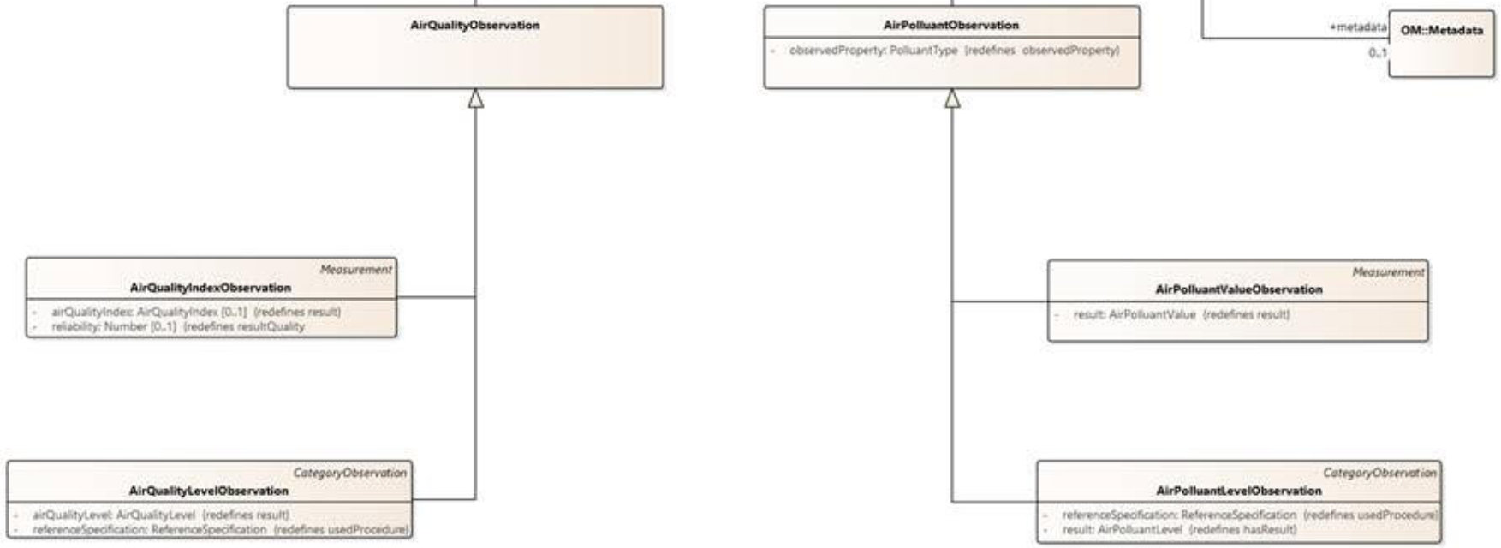
With a difference in the results section

Slide 37
Air model Property, sensor and procedure
Sensor information
Property
What property is observed/measured by the sensor? (temperature, conductivity, CO2, parts per million,...)
Procedure
What procedure was used?
Sensor
What sensor was used?
Platform
On what kind of platform was the sensor installed?
Device
Device information

Slide 38
Air model Metadata
Metadata information
Who produced the observation?
When?
Status of the observation: archived/cancelled/planned/acquired/…
Information on processing of the data
...

Slide 39
Air model Observations
Feature of interest
What object do we observe?
Air in specific location
Room
Spatial sampling feature
We cannot sample the entire lake, so we use specific sample points to represent the object
What proxy object do we observe?
Location
Sample

Slide 40
Air model Observations
Both observations have been split out into Measurements (where, when, what) and CategoryObservations (value or level)
Air quality observation
Air quality index (Measurement)
Air quality level (CategoryObservations)
Air pollutant observation
Air pollutant value (Measurement)
Air pollutant level (CategoryObservations)

Slide 41
Air model Observations
Observation information
The activity of observing
At what time?
Observation parameters?
Feature of interest
Date & time
Result
Observed property
...
Observation collection
A collection of one or more observations, whose members share a common value for one or more properties. (the next slide will put this in a more practical example)

Slide 42
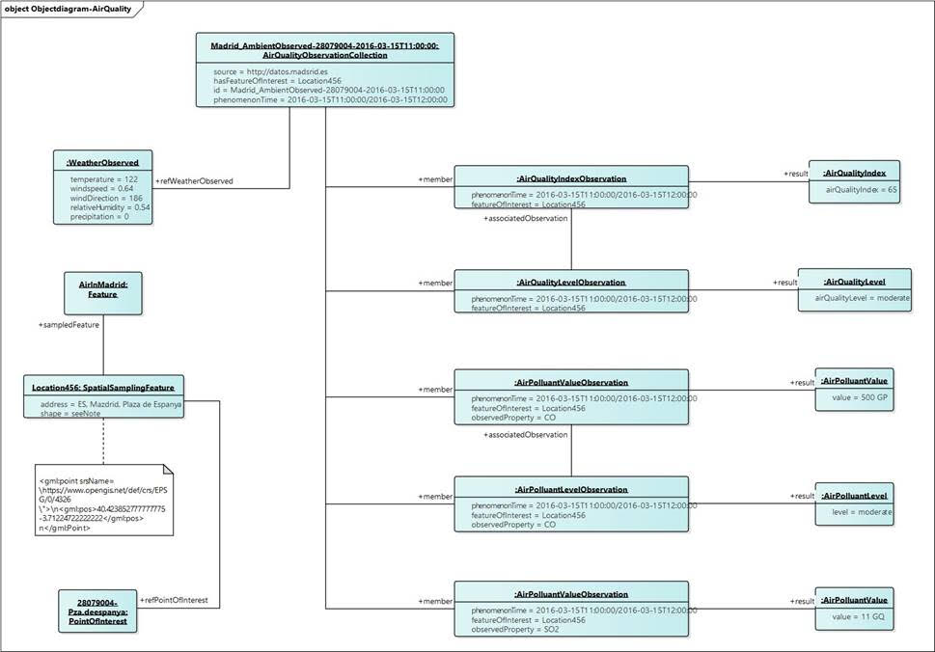
Air model Object diagram

Slide 43
A small break...

Slide 44
Welcome back!

Slide 45
Breakout sessions
Notes:
Kevin

Slide 46






Breakout sessions
Air model
Water model
Group 1
Stay in this meeting
Group 2
Other Teams meeting
Feedback session 20’
Please provide feedback on any of the classes presented:
Are we missing anything
Is something unclear
Do we cover your use-cases

Slide 47

Debrief

Slide 48
Specific models brought up in TW1
Notes:
Kevin

Slide 49

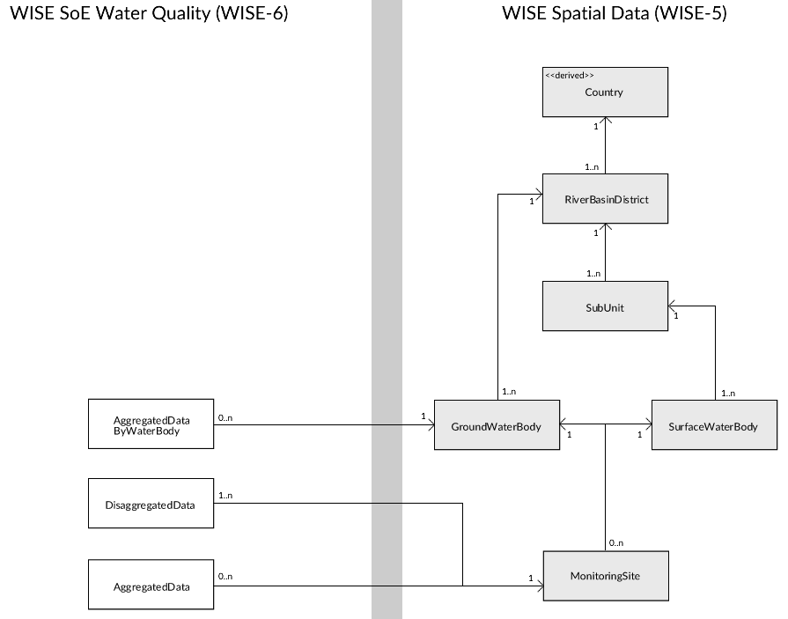
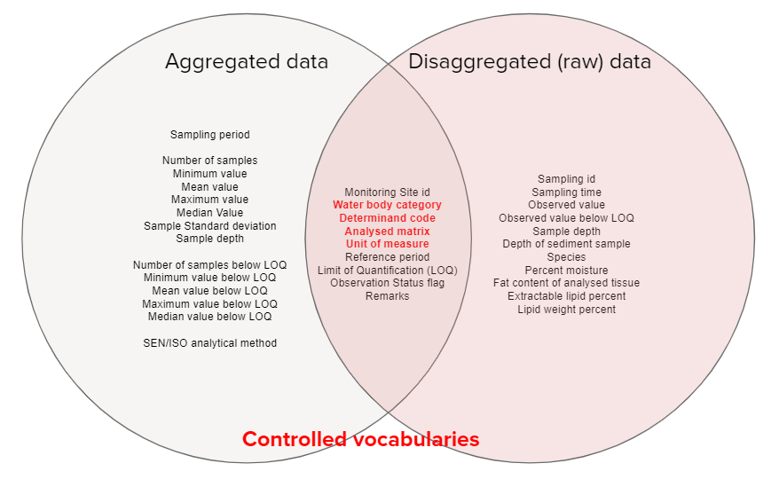
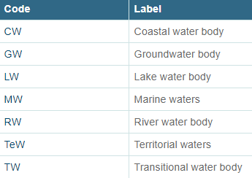
WISE SoE - Water Quality ICM
2 ways of reporting on water quality, namely:
Raw data (e.g. sample values)
Annually aggregated data by monitoring site

Slide 50

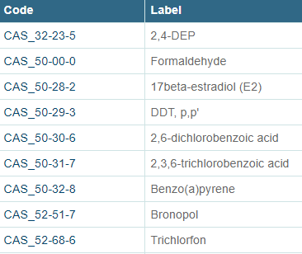

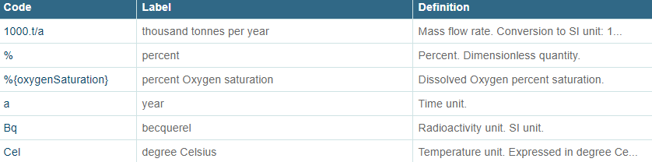
Wise: 2 types of determinands
Pollution from oxygen consuming substances
Nutrient enrichment / eutrophication
Hazardous substances and emerging chemicals (pesticides, metals & metalloids, …)
Other pressures affecting water quality (salinization, acidification, thermal, Climate change)
In total 879 of determinands linked to a specific codes as well as 67 units of measurements.
Water Quality
Oxygen consuming substances - organic pollution
Nutrient enrichment / eutrophication
Hazardous substances and emerging chemicals
Emission to water

Slide 51
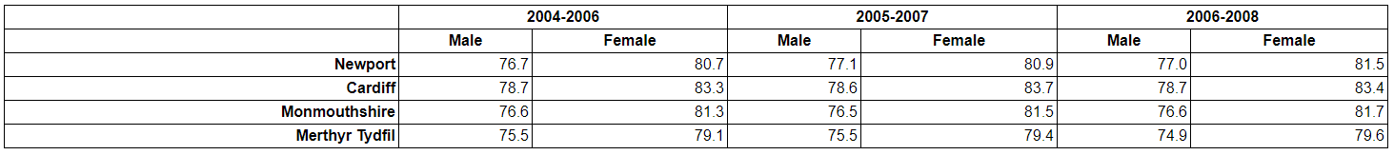
W3 Cube
Data Cube Vocabulary is focused on the publication of multidimensional data on the web
Components of Cube
Actual observations
Organizational structure needed to know the value of each dimension at which the observation is located
Metadata to be able to interpret the observations
Reference metadata to describe the dataset as a whole
Slices
Used to group subsets of observations within a dataset
Usually by fixing all but one dimension (for example time in example below)
Notes:
https://www.w3.org/TR/2014/REC-vocab-data-cube-20140116/

Slide 52
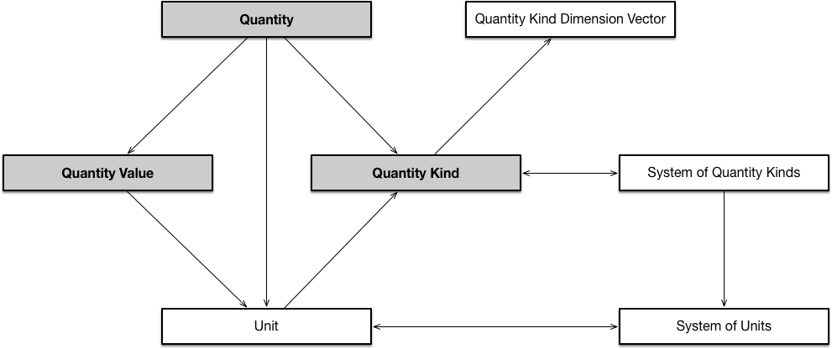
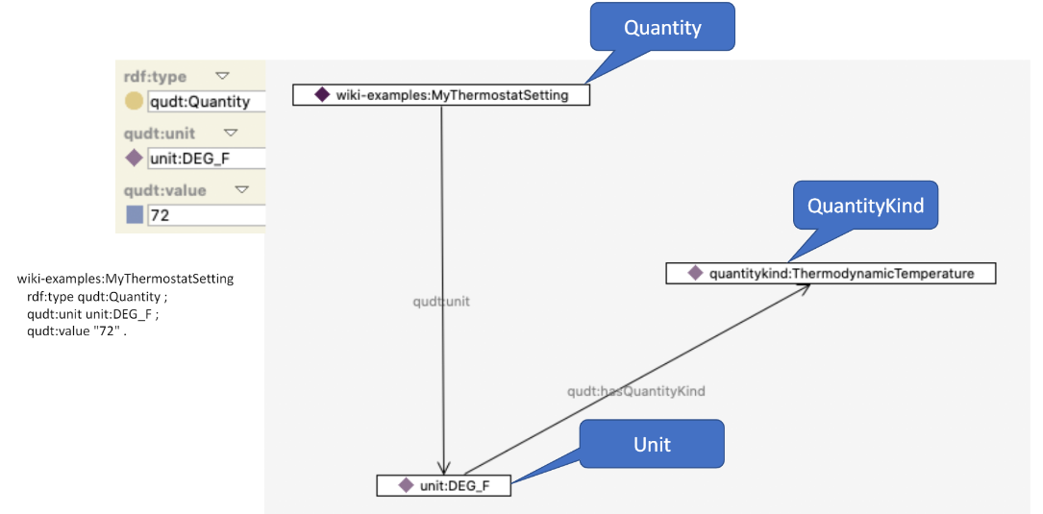
QUDT
Initially developed for Nasa
Provides formal way of specifying units explicitly in order to avoid tacit conventions that are prone to misinterpretation
QUDT overall
1522 units
746 quantity kinds
148 dimension vectors

Slide 53
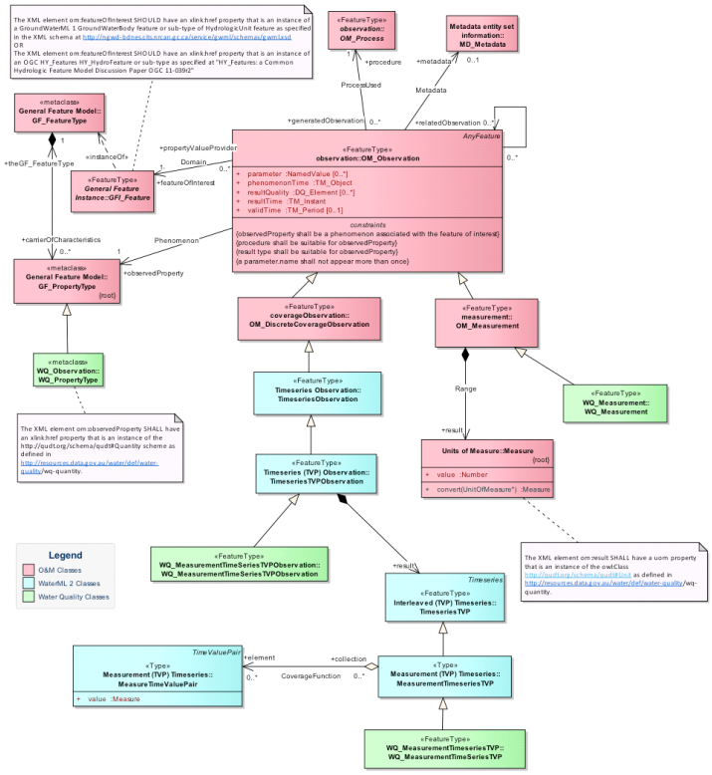
WaterML Water Quality
Mainly specialization of base objects of ISO O&M, more specifically WQ PropertyType, Measurement & WQ Timeseries
PropertyType reuses QUDT for unit of measurements
WQ Measurement also reuses QUDT with addition of some water quality units

Slide 54
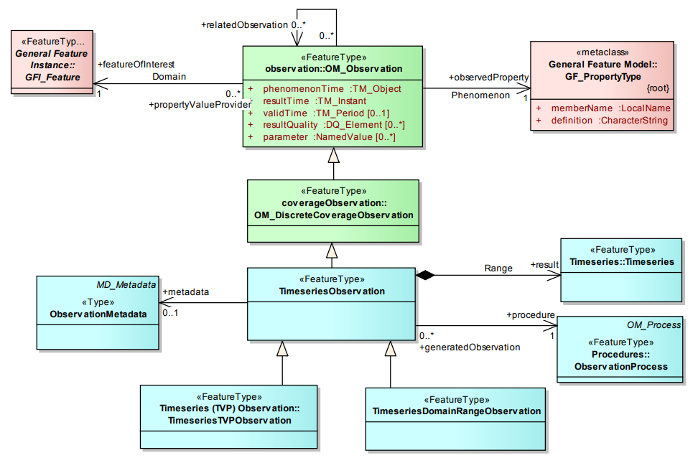
WaterML 2
OM:Observations whose result is a discrete coverage that varies in time
Time Series Observation as a specialization of OM_DiscreteCoverageObservation and provides 2 alternatives for Time Series observations in terms of structuring of the timeseries result:
TimeseriesTVPObservation
Returns timeseries with the time-value pair coupled
[ [time1 , value1] , [time2 , value2] … ]
TimeseriesDomainRangeObservation
Returns timeseries with time and values represented separately
[time1 , time2 , time3 … ] [value1 , value2 , value3 …]

Slide 55
Questions for changes
Notes:
Kevin

Slide 56

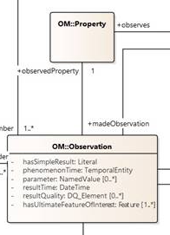
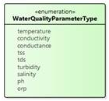
observedProperties
We will have to foresee standardised lists of observedProperties:
A different standard list for Airquality and Waterquality
For water we are looking at QUDT and WaterML
WISE talks about CAS and EEA
does anyone have any experience with these lists?
http://dd.eionet.europa.eu/dataelements/75873
Possible options
We leave the lists to be customizable to whoever exchanges data, as long as the properties are identified via a URI (e.g. SKOS:Concept)
We suggest standardized lists in the specifications
We create our own taxonomy/list from what is available
Notes:
Darwin model also

Slide 57
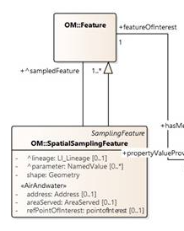
featuresOfIntertest
Our suggestion is to model the featuresOfInterest
For AirQuality the ultimateFeatureOfInterest is “the air”
However, for WaterQuality WISE suggests the following (link):
CoastalWaterBody
GroundwaterBody
LakewaterBody
MarineWaters
RiverWaterBody
TerritorialWaters
TransitionalWaterBody
Possible options
Only model it for WaterQuality based on WISE
Model it for both Air and Water
Don’t model it, but use standardised codelists/taxonomy
Notes:
WaterML : http://docs.opengeospatial.org/is/14-111r6/14-111r6.html#_the_hy_features_conceptual_model

Slide 58

SamplingFeatures
Our suggestion is to add an extra class that allows tracking Specimen:
The WISE model allows pointing towards physical samples creating two classes:
SpatialSamplingFeatures
Specimens
In SOSA they go even more into detail by adding:
SOSA:Sampling - the activity of the sampling
SOSA:Sampler - the specific instruments used
If there is no use-case for this, we would not put this in scope
Possible options
Add the Specimens class
Add the Specimens class, SOSA:Sampling and SOSA:Sampler
Notes:
WaterML : http://docs.opengeospatial.org/is/14-111r6/14-111r6.html#_the_hy_features_conceptual_model

Slide 59
Observations
We suggest to expand Observations with other subtypes on top of Measurements.
ISO O&M has many basetypes available:
Measurement: value + unit
CategoryObservation: classification
CountObservation: count
TruthObservation: true/false observations (e.g. does this observation occur on location XY?)
TemporalObservation: when does the observed characteristics occur
GeometryObservation: where does the observation occur
ComplexObservation: for complex results
DiscreteCoverageObservation: spatial or temporal variation of a phenomenon (TimeSeries)
We have also added MeasurementSeries in the context of OSLO Bodem & Ondergrond (Soil & substrate)
Variation of something in function of another variable: y=f(x)
Possible options
We explicitly add all subtypes
We implicitly add the subtypes by adding them to the diagram, but referring to ISO O&M for definitions
Notes:
WaterML : http://docs.opengeospatial.org/is/14-111r6/14-111r6.html#_the_hy_features_conceptual_model

Slide 60

ObservationCollection
We have two ways of depicting variation of data in one or more dimensions:
Via a Cube:datasets (as presented earlier) and it’s Slices (1 dimension-datasets) or,
Via SOSA extensions which applies the same concept but through ObservationCollections, which is already a part of our core model.
This means we can make aggregations of data in 1 or multiple dimensions using:
featureOfInterest/ultimateFeatureOfInterest
phenomenonTime/resultTime
observedProperty
sensor
usedProcedure
Open question
In order to make an aggregation based on the data (median, mean), will our current model cover that? Or do we have to add more statistical terminology within the model?
Notes:
WaterML : http://docs.opengeospatial.org/is/14-111r6/14-111r6.html#_the_hy_features_conceptual_model

Slide 61

Issues logged on Github
https://github.com/Informatievlaanderen/OSLOthema-airAndWater

Slide 62
Definitions
Notes:
Kevin

Slide 63
Github collaboration on Definitions
Class | Definition | Origin
Observation | An observation is the act of observing a property. | ISO O&M
Property | A property is a facet or attribute of an object referenced by a name. | ISO O&M
Feature | Features are abstractions of real-world phenomena. | ISO O&M
SpatialSamplingFeature | Spatially defined part of the Object to be observed and representative of that Object | ISO O&M
Metadata | Data that contains information about data. | ISO O&M
Procedure | A workflow, protocol, plan, algorithm, or computational method specifying how to make an observation, create a sample, or make a change to the state of the world (via an actuator). A procedure is re-usable, and might be involved in many observations, samplings or actuations. It explains the steps to be carried out to arrived at reproducible results. | SOSA
Sensor | Device, agent (including humans), or software (simulation) involved in, or implementing, a procedure. Sensors respond to a stimulus, e.e., a change in the environment, or Input data composed from the Results of prior observations, and generate a result. Sensors can be hosted by platforms. | SOSA
Platform | A platform is an entity that hosts other entities, particularly sensors, actuators, samplers and other platforms. | SOSA
ObservationCollection | A collection of one or more observations, whose members share a common value for one or more properties. | SOSA-extension
System | System is a unit of abstraction for pieces of infrastructure that implment Procedures. A system may have components, it's subsystems, which are other Systems. | SSN
SystemCapability | Describes normal measurement, actuation, sampling properties such as accuracy, range, precision etc… of a system under some specified conditions such as a temperature range. The capabilities specified here are those that affect the promary purpose of the system, while those in operatingrange represent the system's normal operating environment, including conditions that don't affect the observation or the actuations. | SSN
SurvivalRange | Describes survivalproperties of a system under some specified conditions. For example the lifetime of a system under a specified temperature range. | SSN
Device | An apparatus (hardware + software / firmware) intended to accomplish a particular task (sensing the environment, actuating, …). A device is a tangible object which contains some logic and is producer and/or consumer of data. A device is always assumed to be capable of communicating electronically via a network. | FIWARE
Review of definitions on Github
Provide feedback
Captation & consolidation of feedback
Presentation of definitions on TW3

Slide 64
Next steps
Notes:
Kevin

Slide 65


Next Steps
Attributes for other classes such as e.d. Devices based on the FIWARE:DeviceModel
Receive feedback on initial draft definitions & consolidate
Extend list of definitions

Slide 66
Focus of the next webinar
Fine-tuning and extending the model
In-depth discussion on the attributes
Review and get feedback on the definitions

Slide 67
Feedback & collaboration
Feedback can be provided by email to the following people:
annelies.decraene@vlaanderen.be
michiel.dekeyzer@vlaanderen.be
kevin.haleydt@vlaanderen.be
frederik.van.den.houdt@pwc.com
Feedback/input can be provided through GitHub: https://github.com/Informatievlaanderen/OSLOthema-airAndWater
Please provide us with your username so we can invite you!

Slide 68
Are there any questions left?

Slide 69
Thanks!

